Slide 1
Fixed Assets
ACCESS
493 Bev Rd
Boardman, OH 44512
Fiscal Year-End
Closing Procedures
2025

Slide 2
Pre-Closing Procedures
Items received on or prior to June 30^{th,} 2025 should be added to Inventory for FY2025
Items received after June 30th can be added to the pending file for FY2026
If depreciation has been changed on several items so that it’s necessary to completely recalculate the life-to-date (LTD) depreciation, you may select the desired items from the Items grid and select Depreciate
NOTE: Recalculating depreciation will affect items that have had improvements (additional acquisitions added throughout the life of the item) causing items to lose their true depreciation history.
Please refer to the Depreciation chapter in the Appendix or Depreciation Adjustments section of Items for further information on the depreciate option

Slide 3
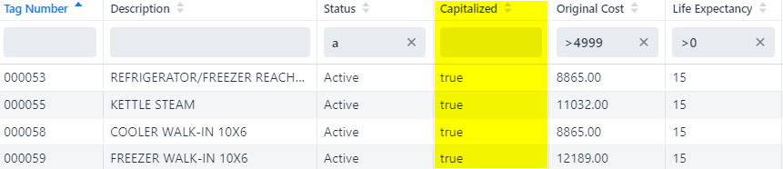
Pre-Closing Procedures
Ensure items that meet or exceed the entity's capitalization threshold are marked as 'capitalized'. On the Items grid, add the 'capitalized' column and filter using their capitalization threshold. If there are items that meet the threshold criteria but are marked false under capitalized, these items need to be looked into further as to why they are not capitalized.
  For example: the entity has a dollar threshold of $5000 and a life expectancy of 1 year.

Slide 4
Item Organization
Item Groups
  Each item is designated a Fund, Function, and Asset Class
  These groupings are used to sort and group items on reports in the software
    Fund
    Function
    Asset Class

Slide 5
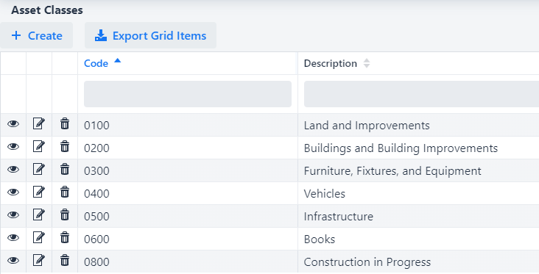
Item Organization
Core Menu
  The different options for each of these groups is defined in the Core menu. These are configured by the district so the setup and details will vary

Slide 6
Item Organization
Core > Funds
  Funds are used to define the item's current fund for which an item is currently being used.
  The fund code is not necessarily the source from which the item was purchased.
  The Fund code is also attached to a fund Type: Governmental, Proprietary, Fiduciary
Source vs. Fund Code
  Each item will only be linked to ONE fund code, regardless of how many acquisitions it could have been purchased from
  Most reports that sort by “Fund” are using the fund code from the item
  Exceptions to this are reports that reference “Source”
    Source reports will look at the acquisition account code from the PO

Slide 7
Item Amounts
Original Cost
  The cost of the item as given on the purchase order(s) or the sum of all acquisition amounts for the tag number.
  This cannot be manually changed, this will always be the total of the existing acquisitions
  Part of what determines the Capitalization of the item
LTD Depreciation
  The Life-to-date depreciation. This is the total amount of depreciation for the item from the beginning depreciation date until the last fiscal year closed.

Slide 8
Fiscal Year-End Closing Procedures
When all assets have been entered for the FY, district can run the recommended list of reports (this includes all necessary GAAP reports if GAAP is enabled for the entity).
All recommended FYE reports are explained in the upcoming slides.

Slide 9
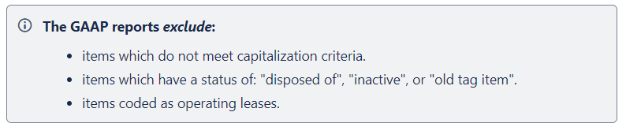
GAAP Reports
GAAP Reports
All GAAP reports are canned reports and are located under the Reports menu. They are generated in PDF format only. The reports contain separate sections for each fund type (governmental, proprietary, fiduciary).
GAAP reports only show Items that meet certain criteria

Slide 10
GAAP Reports
Fixed Assets by Source…..summary of the original cost of capitalized items by their source (or fund) the items were charged to on the purchase order
  Source means “the fund the items were originally charged to when purchased”
  uses the PO information from the acquisition record to identify the source fund used in purchasing the items.
  Report Filename: FixedAssetBySourceReport.pdf

Slide 11
GAAP Reports
Fixed Asset by Function and Class….schedule of fixed assets by function and class.
  May generate up to three different report formats:
    Schedule by Function & Class - displays original cost & book value
    Schedule by Class - displays original cost & book value
    Summary by Function and Class - choose to summarize by 2-digit function and may report on original cost or book value
      For FYE, it is recommended to generate the report for all three formats
  Book Value is the Original Cost minus Total Depreciation
  Report Filename: FixedAssetByFuncClassReport.pdf

Slide 12
GAAP Reports
Schedule of Change in Fixed Assets
Contains “changes” in capital assets during the current fiscal year
Ability to generate a summary or detail report
Ability to generate the report by asset class, fund or function.
  For FYE, it is recommended to generate the report for all three types
Report Name: ScheduleOfChangeReport.pdf
Summary report lists the beginning balance, acquisitions, dispositions, transfers in/out, adjustments and the ending balance in column format.
Detailed report lists individual tags that make up the acquisitions, dispositions, transfers, or adjustments amounts that happened in the year.
Notes:
Output reports subtotal by fund type (fiduciary, governmental, proprietary, and unknown.
The GAAP flag must be enabled to be able to generate this report.
Specific entity_IDs can be included or excluded (i.e. NOGAAP)

Slide 13
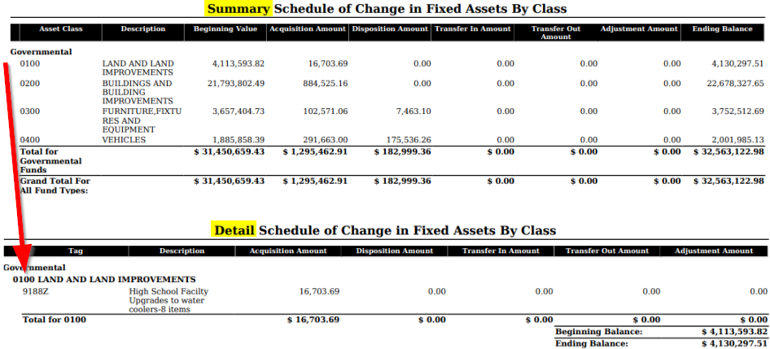

Slide 14
GAAP Reports
Totals on the
  Fixed Assets by Source
  Fixed Asset by Function and Class
  Schedule of Change in Fixed Assets
Original Cost amounts should match when balancing out for the fiscal year-end.

Slide 15
GAAP Reports
Schedule of Changes in Depreciation
Contains “changes” in depreciation of capital assets during the current fiscal year
Ability to generate a summary or detail report
Ability to generate the report by asset class, fund or function
  For FYE, it is recommended to generate the report for all three types
Report Name: ScheduleOfChangeInDepreciationReport.pdf
Summary report lists the beginning depreciation, continuing items, acquisitions, dispositions, transfers, adjustments and ending depreciation balance in column format.
  Detailed report lists individual tags that make up the acquisitions, dispositions, transfers or adjustment amounts.
Notes:
The GAAP flag must be enabled in order to generate a valid report.
May be used as a depreciation balancing tool with the Book Value.

Slide 16
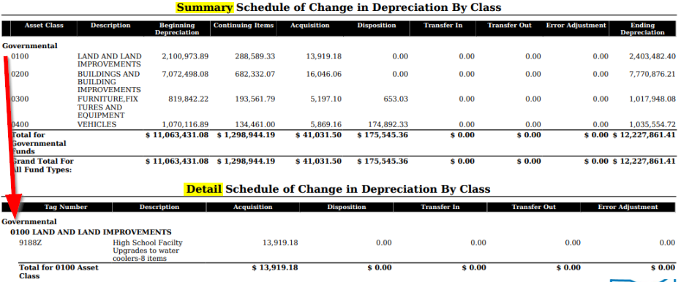

Slide 17
Suggested Non-GAAP Reports
Asset Listing by Grant/Source….listing of acquisition transaction data by source account code and/or grant identifier
Brief Asset Listing….. brief listing (one line per item) of all assets or a subset of them.
  Recommended 5 versions of the Brief Asset generated at FYE
    Include capitalized items only and Status codes of “Active, New, Excess Asset Held for Sale, and Excess Asset Not in Use (with the exception of the disposition report)
      Brief Asset Listing by fund
      Brief Asset Listing by function
      Brief Asset Listing by asset class
      Acquisitions for current fiscal year
      Dispositions for current fiscal year

Slide 18
Suggested Non-GAAP Reports
Book Value Report…..displays depreciation information listing original cost, salvage value, book value, % of depreciation, and last year of useful life.
  The current FY is used for the reporting date.
  Recommended 4 versions generated at FYE
    Include capitalized items only and Status codes of Active, New, Excess Asset Held for Sale, and Excess Asset Not in Use (with the exception of the disposition reports below).
      Book Value Report by function
      Book Value Report by class
      Depreciation for current FY dispositions by function
      Depreciation for current FY dispositions by class

Slide 19
Suggested Non-GAAP Reports
  Audit Report
  tracks changes made in the application
Depreciation Posting Report
  contains the projected FTD depreciation and Book Value amounts, sorted and subtotaled by asset fund with a grand total at the bottom of the report
Fiscal Year Ending Balances Report
  contains the projected ending (original cost) balances for the current fiscal year (displayed in 'Current Fiscal Year' field)

Slide 20
Fiscal Year-End Closing Procedure
Close the current fiscal year by clicking the Close Icon in Core>Fiscal Years
  Advances ‘Last Closed Fiscal Year’ date in Core>Configuration by one year
  Adds one year’s worth of depreciation to LTD depreciation field
  Updates beginning balance fields for new FY on the item record
  Generates Inventory FYE Bundle
    Generates the necessary reports and sends them to Document Storage
Notes:
Document Store will be out in Quarter 2 (before end of June)

Slide 21
FYE Bundle
  Document Storage page is not currently visible. Will be added to the System menu when Document Store is released
  Will be visible to users with INV_STANDARD or higher level access
  FYE Bundle zip file will no longer be emailed. Document Storage is anticipated to be released June 2025. If the fiscal year is closed prior to Document Store being available, a FYE bundle will be generated and sent to the email in Core > Configuration.
  Initial implementation will not include option to import previous FY reports but is planned for a future update
Notes:
Document Store will be out in Quarter 2 (before end of June)

Slide 22
Fiscal Year-End Closing Procedure
In Core>Fiscal Years, create FY2026, open the year and make it current to start processing inventory for the new year
If GAAP flag is not enabled and the district would like to start on GAAP for the next fiscal year, please contact ACCESS
  Once enabled, district may then start entering inventory for the new fiscal year
Notes:
Do you have any districts they currently do not have their GAAP flag set but would like to for the beginning of FY23?

Slide 23
Questions?

